Slide 1


DIGITAL PORTFOLIO

Slide 2



INTRODUCTION
•STUDENT NAME:
•REGISTER NO AND NM ID:
•DEPARTMENT:
•COLLEGE:
ALEENA MARIAM N
C0BCD813E06FAA48EF24419CA16679A6
B.Sc.Computer Science
TAW college for women, Thiruvalluvar university

Slide 3

AGENDA
1.Problem Statement
2.Project Overview
3.End Users
4.Tools and Technologies
5.Portfolio Design and Layout
6.Features and Functionality
7.Results and Screenshots
8.Colclusion
Github link

Slide 4


PROBLEM STATEMENT
In today’s digital era, students and professionals need an online space to showcase their skills, achievements, and projects. Traditional resumes often fail to highlight creativity and technical abilities. A digital portfolio solves this by providing an interactive and visually appealing platform to present one’s journey, skills, and accomplishments.

Slide 5

PROJECT OVERVIEW
This project is a personal digital portfolio website developed using web technologies. It is designed to reflect both technical and creative aspects, allowing visitors to learn about my academic background, skills, achievements, and contact details. The portfolio acts as an extended resume and a professional identity on the web.

Slide 6


END USERS
•Recruiters and Employers – To evaluate skills, projects, and achievements.
•Peers and Educators – To view academic performance and accomplishments.
•General Visitors – To get to know me, my journey, and my areas of interest.

Slide 7


TOOLS AND TECHNOLOGY
•Frontend:HTML5, CSS3, JavaScript
•Design Tools: Canva, Figma
•Development Environment: VS Code
•Version Control: Git, GitHub (for deployment via GitHub Pages)

Slide 8


PORTFOLIO DESIGN AND LAYOUT
•Homepage – Introduction and professional tagline.
•About Section – Academic details, personal journey, and background.
•Skills Section – Percentage-based skill visualization for programming and tools.
•Achievements Section – Awards, recognitions, and competition results.
•Contact Section – Email, phone number, and location for easy reach.
•Navigation – Simple, user-friendly, and responsive across devices.

Slide 9


FEATURES AND FUNCTIONALITY
•Responsive design – Works on desktop, tablet, and mobile.
•Interactive skill bars – Showcasing proficiency levels.
•Visual storytelling – Journey explained with a personal touch.
•Contact information – Easy access for networking opportunities.
•Hosted on GitHub Pages – Publicly accessible and free hosting.

Slide 10

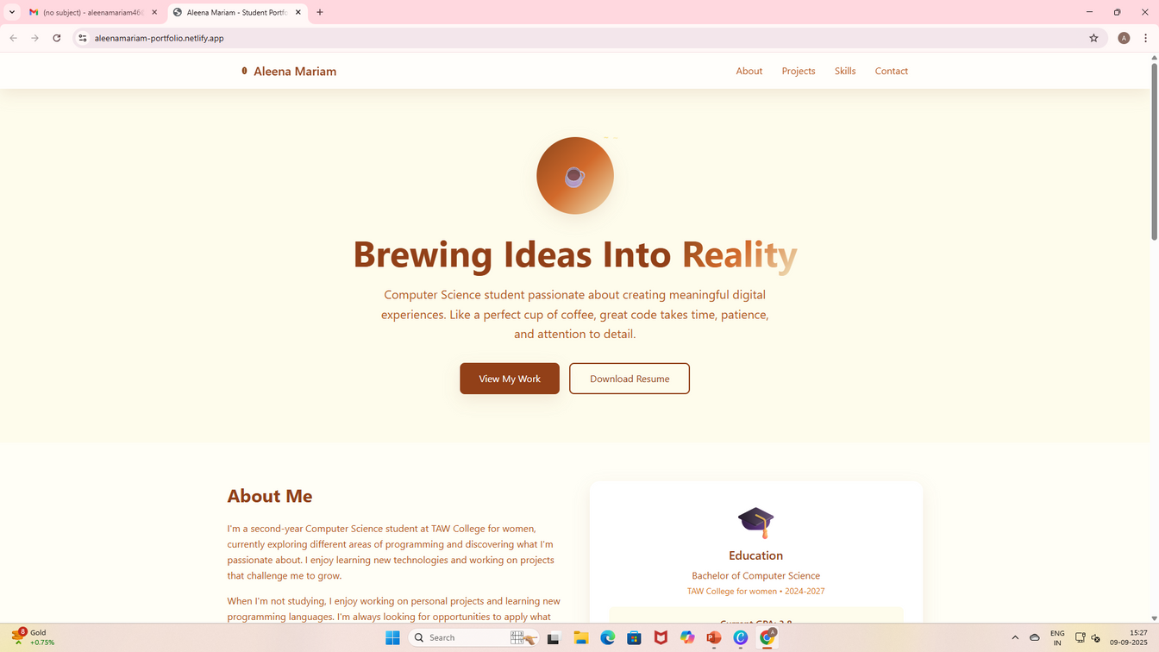
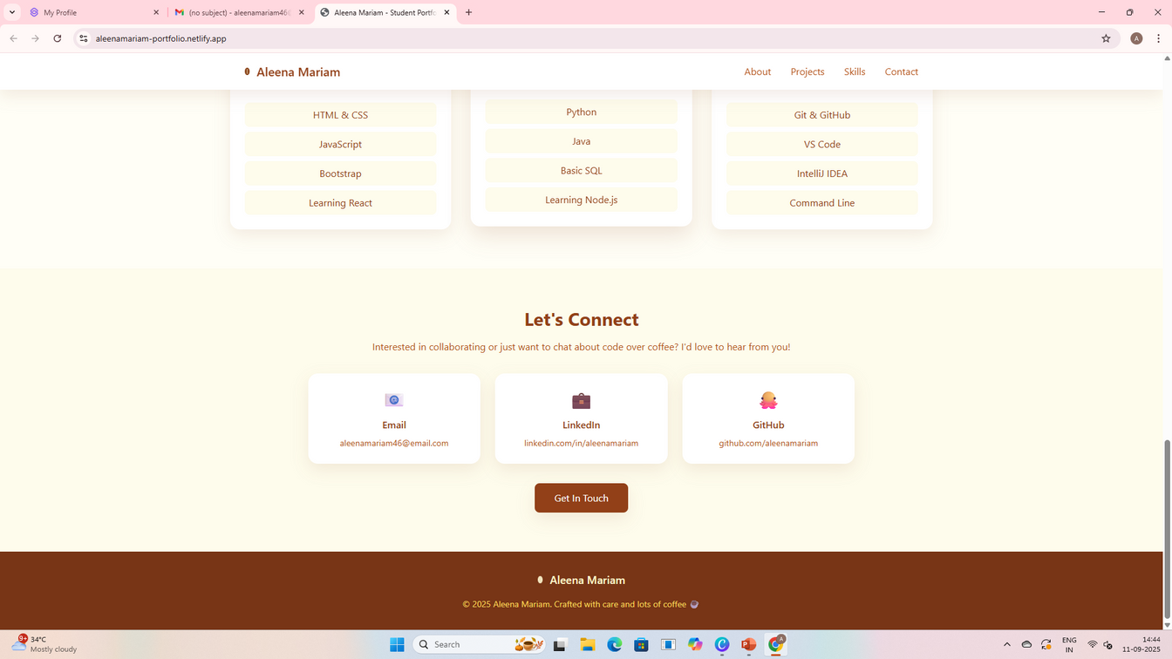
RESULTS AND SCREENSHOTS
•Successfully deployed portfolio accessible via GitHub Pages.
•Professional online identity created.
•Showcases technical skills, creativity, and academic achievements.

Slide 11
CONCLUSION
The Digital Portfolio project highlights both technical and creative skills, providing a professional online presence. It not only enhances visibility for career opportunities but also demonstrates expertise in web development, design tools, and self-presentation. The project serves as a foundation for future improvements, such as adding projects, blogs, or certifications.

Slide 12
Thank You

